Slide 1
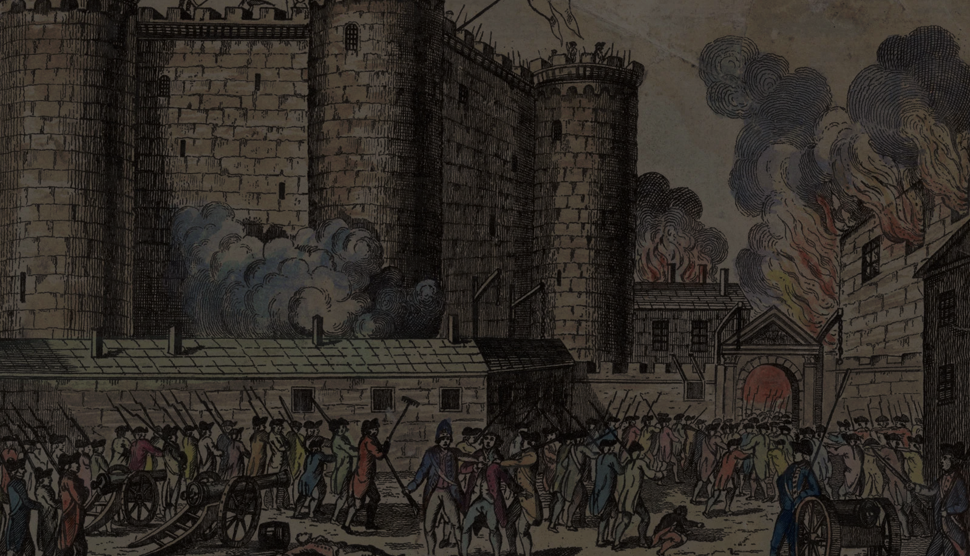
THE
IN 1789…
FRENCH
storming of the Bastille, iconic conflict of the French Revolution. On July 14, 1789, fears that King Louis XVI was about to arrest France’s newly constituted National Assembly led a crowd of Parisians to successfully besiege the Bastille, an old fortress that had been used since 1659 as a state prison.
REVOLUTION

Slide 2
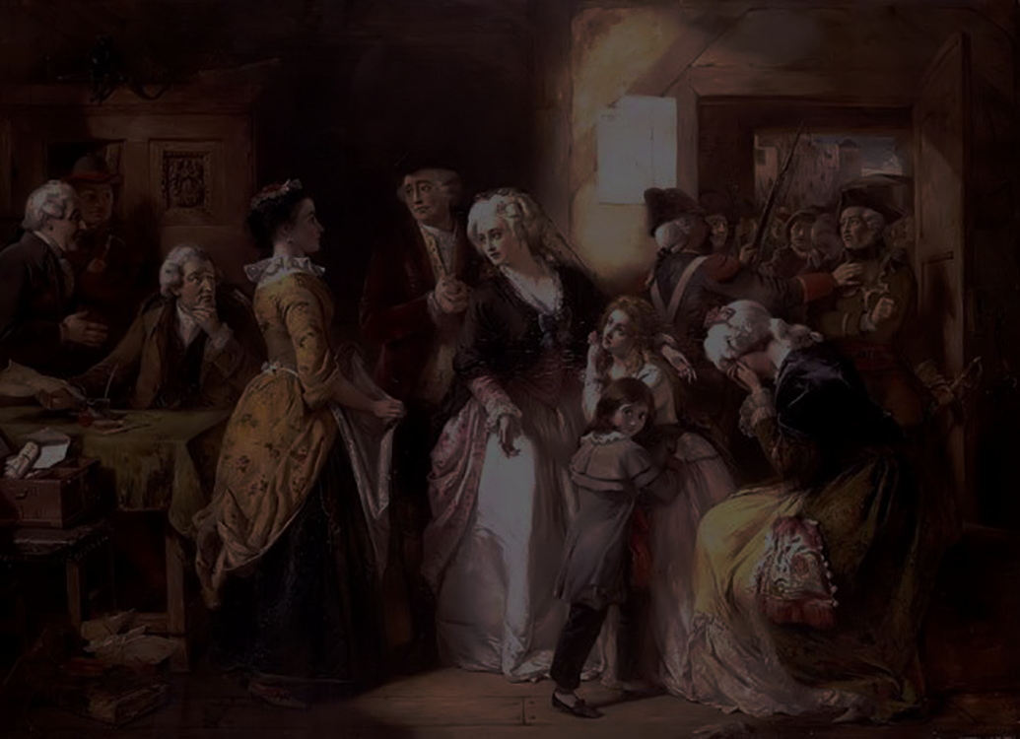
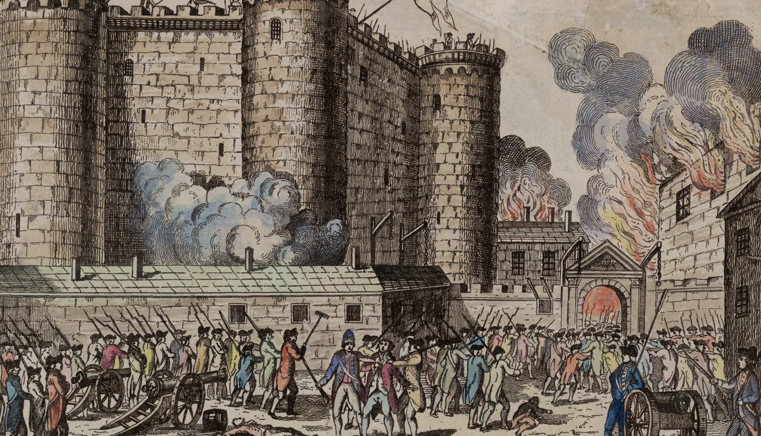
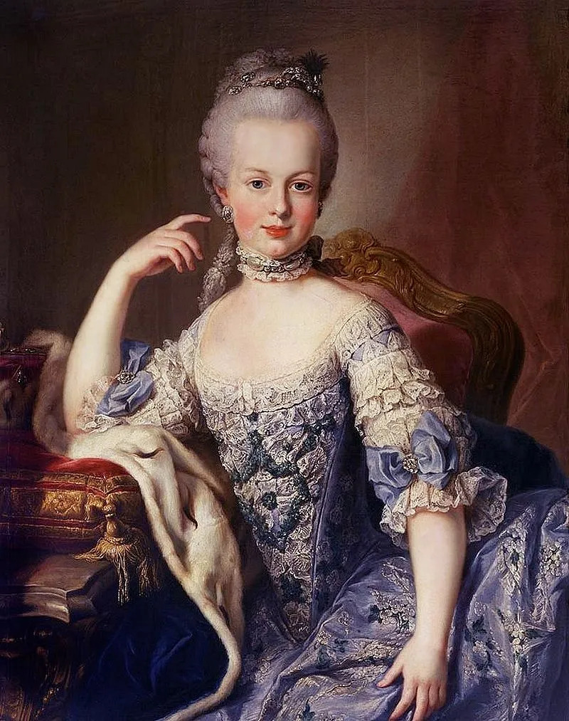
THE
FRENCH
REVOLUTION
IN 1789…
IN 1789…
storming of the Bastille, iconic conflict of the French Revolution. On July 14, 1789, fears that King Louis XVI was about to arrest France’s newly constituted National Assembly led a crowd of Parisians to successfully besiege the Bastille, an old fortress that had been used since 1659 as a state prison.
The French Revolution had general causes common to all the revolutions of the West at the end of the 18th century and particular causes that explain why it was by far the most violent and the most universally significant of these revolutions.

Slide 3
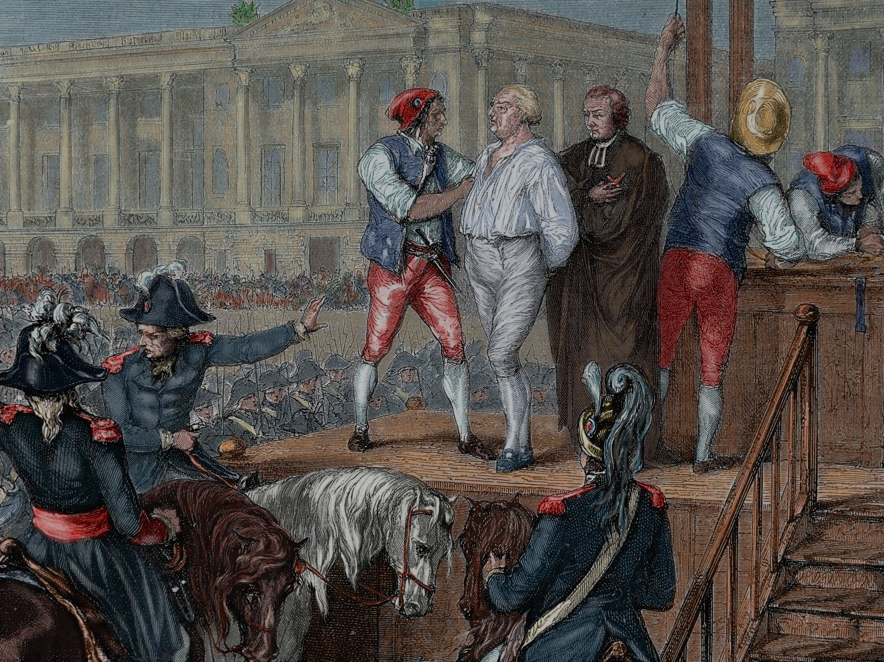
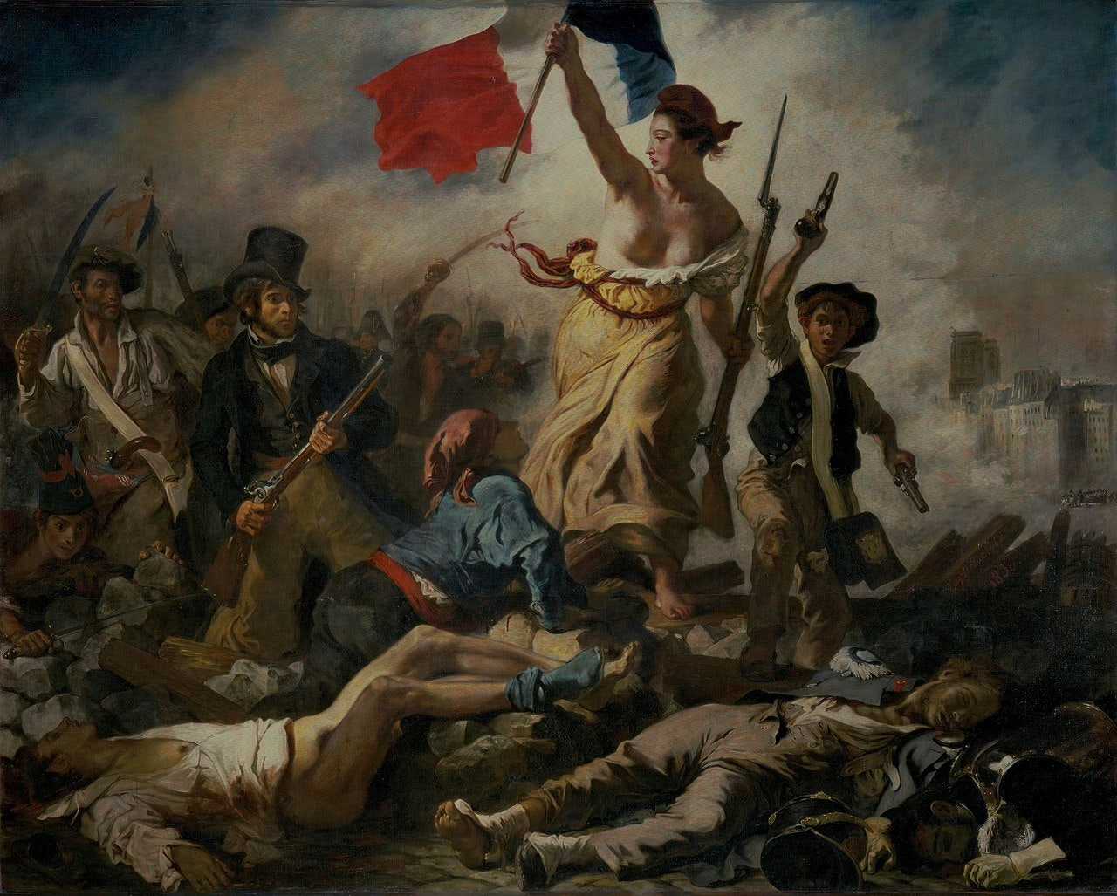
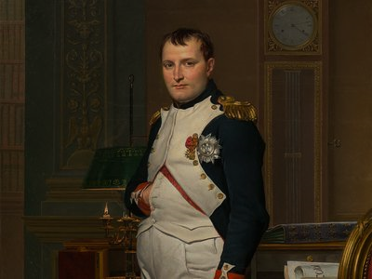
THE
FRENCH
he increasingly numerous and prosperous elite of wealthy commoners—merchants, manufacturers, and professionals, often called the bourgeoisie—aspired to political power in those countries where it did not already possess it.
REVOLUTION
IN 1789…
IN 1789…
storming of the Bastille, iconic conflict of the French Revolution. On July 14, 1789, fears that King Louis XVI was about to arrest France’s newly constituted National Assembly led a crowd of Parisians to successfully besiege the Bastille, an old fortress that had been used since 1659 as a state prison.
The French Revolution had general causes common to all the revolutions of the West at the end of the 18th century and particular causes that explain why it was by far the most violent and the most universally significant of these revolutions.
The peasants, many of whom owned land, had attained an improved standard of living and education and wanted to get rid of the last vestiges of feudalism so as to acquire the full rights of landowners and to be free to increase their holdings.
The first of the general causes was the social structure of the West. The feudal regime had been weakened step-by-step and had already disappeared in parts of Europe.

Slide 4
THE
FRENCH
REVOLUTION
he increasingly numerous and prosperous elite of wealthy commoners—merchants, manufacturers, and professionals, often called the bourgeoisie—aspired to political power in those countries where it did not already possess it.
IN 1789…
The French Revolution had general causes common to all the revolutions of the West at the end of the 18th century and particular causes that explain why it was by far the most violent and the most universally significant of these revolutions.
The first of the general causes was the social structure of the West. The feudal regime had been weakened step-by-step and had already disappeared in parts of Europe.
The peasants, many of whom owned land, had attained an improved standard of living and education and wanted to get rid of the last vestiges of feudalism so as to acquire the full rights of landowners and to be free to increase their holdings.

